Slide 1
Sociology of management and business Administration
Presented by:
Jyomi Bamjan(Tamang)
Bedana Dahal
Saru Bhattarai
Alisha Yogi
Riyasha Dahal

Slide 2
Introduction
Joint collaboration of two independent disciplines: sociology and management.
Sociology of management is a systematic study of human interactions devoted to understanding social relations as human beings from different groups and associations.
Helps in diagnosing and curing management problems.
To overcome from organizational problems certain steps can be taken in consideration for proper benefit.

Slide 3
Organizational Culture: Anthropological gaze
Guides and aids in smooth functioning.
System of shared assumptions , values and beliefs.
Deeply rooted in life of each organization.
The culture of organization eminently influences its myriad decisions and actions.
It has profound impact on business outcomes that are vitally important to business organizations.

Slide 4
ANALYSIS OF ORGANISATION
Organization with narrow span
Close super
Close control
Fast communication
Functional organizational group
Logical reflection of function
Simplifies traning
Furnishes memory

Slide 5
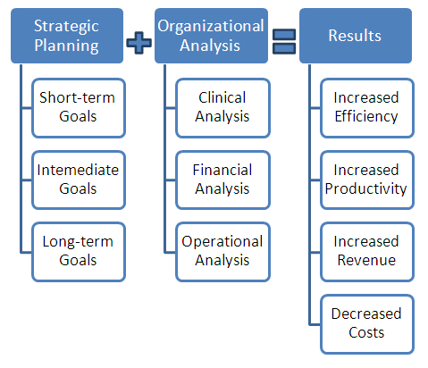

Slide 6
NETWORK AND ORGANIZATION
Network is a link or connection that cements individuals creating a system of participants.
Social groups are important source of network.
Network analysis helps to examine structural arrangements as well as patterning of social relationship within and between organization.
Reciprocity, mutual benefits, cooperation and sense of belongingness cement the relationships between and among group members.

Slide 7
Importance of Networks
Assets to individuals, groups and organizations.
Promotes sense of security, affiliation and support.
Helps in understanding, planning, motivating as well as regularizing behaviors on the workforce.
Get feedback form analysis of network within and across organization.
Helps to operate the organization within space and optimum mobilizing the vivid capitals: social, cultural, symbolic capital.

Slide 8

ANY QUESTIONS?

Slide 9


